Slide 1
MY JOURNAL TO PYTHON
NAME: JAMES RYAN PREGON
TEACHER: MY DEAR GREAT TEACHER

Slide 2
AGENDA
Python
Input and output: input() and print()
Data types:
Operators ON data type:
CONTROLS : IF- | IF –ELSIF |-F-ELSE
LOOP: FOR |WHILE | RANGE() | BREAK | CONTINUE
FUNCTION:
PARAMETERS(ARGUMETNS)
RECURSIVE FUNCTION
LAMBDA FUNCTION

Slide 3
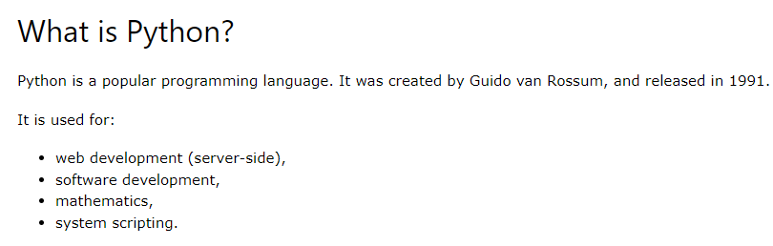
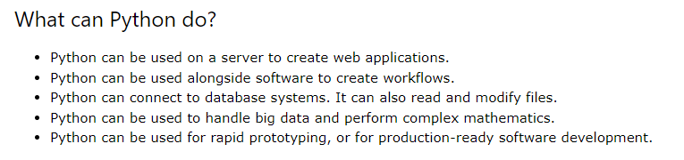
PYTHON

Slide 4
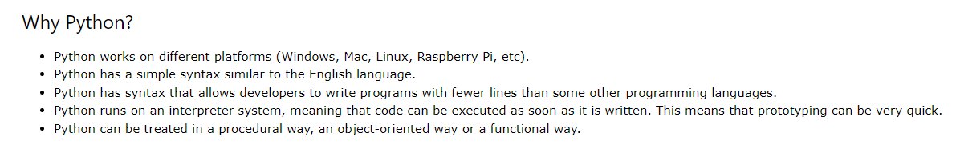
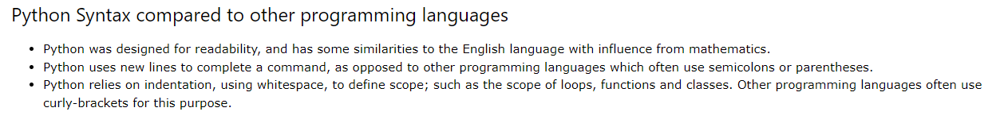
PYTHON

Slide 5
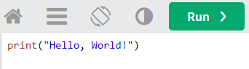
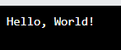
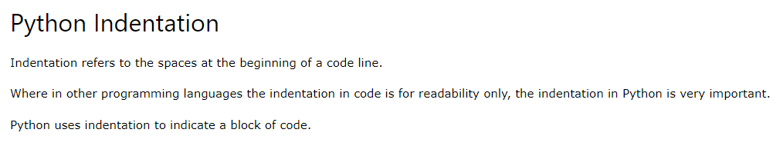
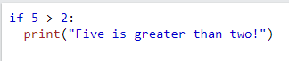
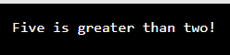
My First Program
Code and output

Slide 6
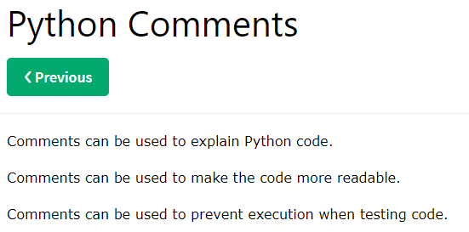
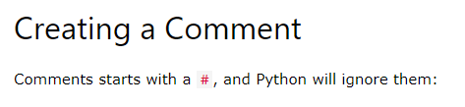
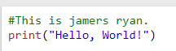
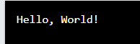
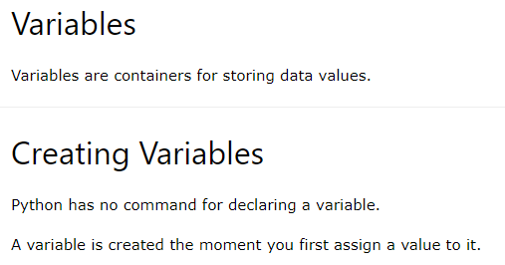
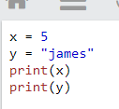
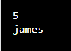
Code and output
Python Variables
Code and output

Slide 7
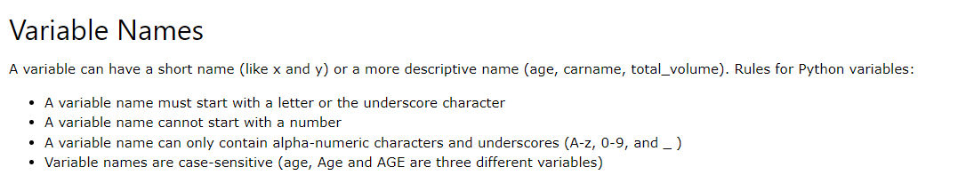
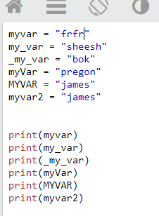
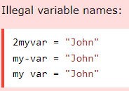
Python - Variable Names
Legal variable name

Slide 8
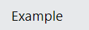
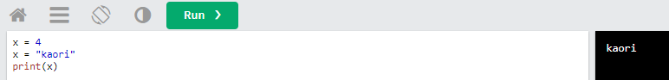
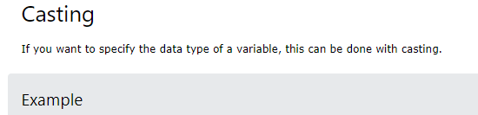
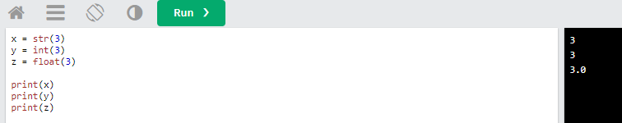
Python - Variable Names

Slide 9
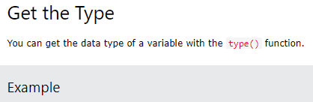
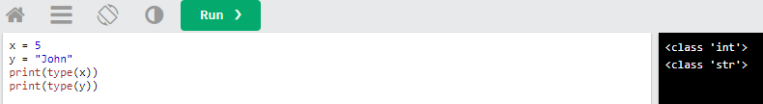
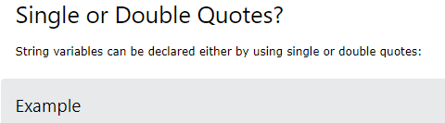
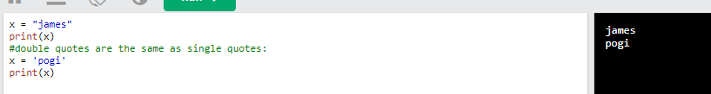
Python - Variable Names

Slide 10
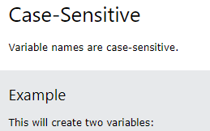
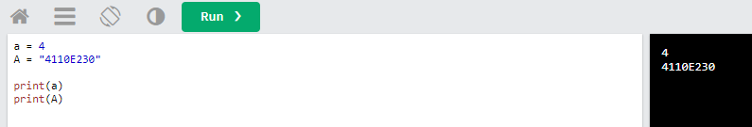
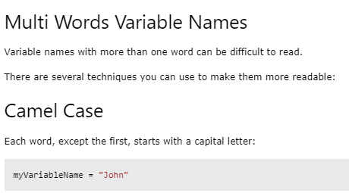
Python - Variable Names

Slide 11
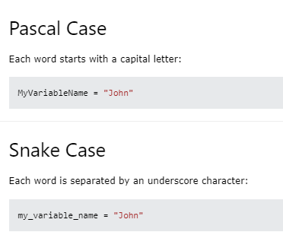
Python - Variable Names

Slide 12
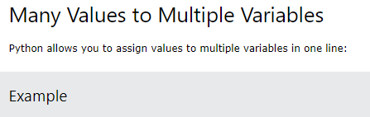
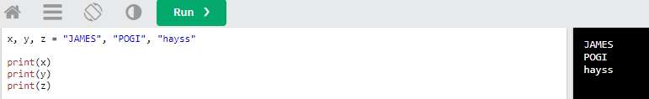
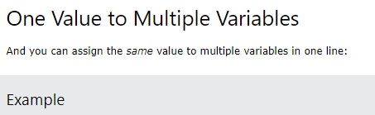
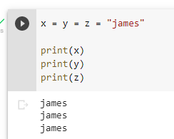
Python - Assign Multiple Values

Slide 13
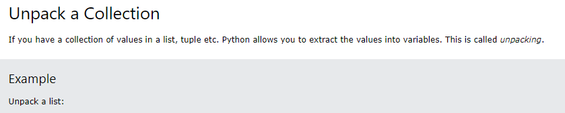
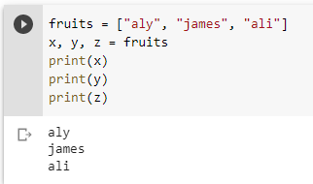
Python - Assign Multiple Values

Slide 14
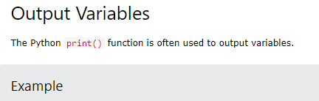
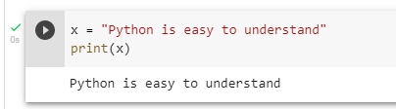
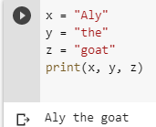
Python - Output Variables

Slide 15
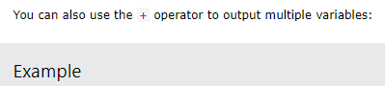
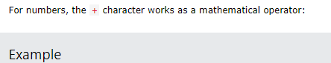
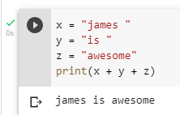
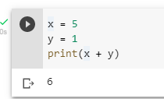
Python - Output Variables

Slide 16
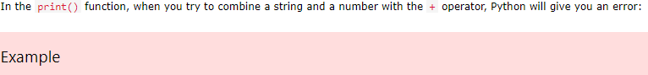
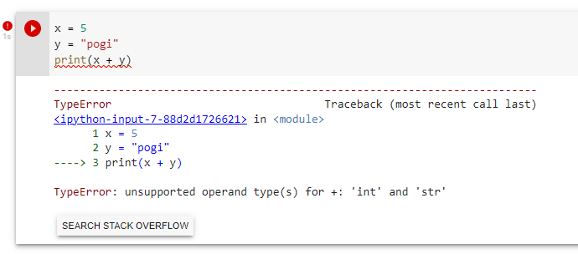
Python - Output Variables

Slide 17
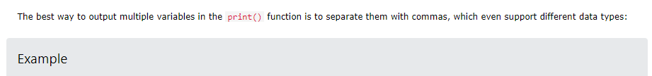
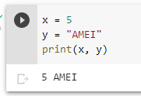
Python - Output Variables

Slide 18
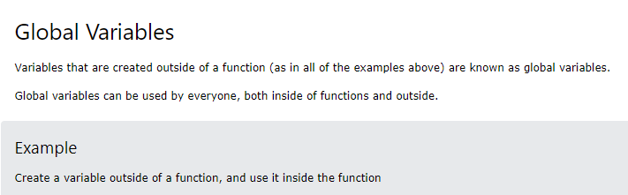
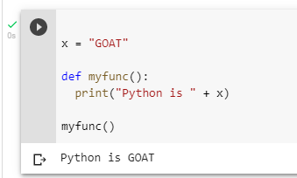
Python - Global Variables

Slide 19


Python - Global Variables

Slide 20


Python - Global Variables

Slide 21


Python - Global Variables

Slide 22


Python - Data Types

Slide 23



Python - Data Types

Slide 24


Python - Data Types

Slide 25

Python - Data Types

Slide 26


Python - Numbers

Slide 27




Python - Numbers

Slide 28




Python - Numbers

Slide 29


Python - Numbers

Slide 30


Python - Numbers

Slide 31


Python - Numbers

Slide 32

Python Casting

Slide 33


Python Casting

Slide 34

Python Casting

Slide 35

Python Casting

Slide 36


Python Strings

Slide 37


Python Strings

Slide 38


Python Strings

Slide 39


Python Strings

Slide 40


Python Strings

Slide 41


Python Strings

Slide 42


Python Strings

Slide 43



Python Strings

Slide 44


Python Strings

Slide 45


Python Strings

Slide 46


Python Strings

Slide 47


Python Strings

Slide 48


Python Strings

Slide 49

Python Strings

Slide 50

Python Strings

Slide 51

Python Strings

Slide 52


Python Strings

Slide 53


Python Strings

Slide 54


Python Strings

Slide 55


Python Strings

Slide 56


Python Strings

Slide 57

Python Strings

Slide 58

Python Strings

Slide 59


Python Strings

Slide 60


Python Booleans

Slide 61


Python Booleans

Slide 62


Python Booleans

Slide 63


Python Booleans

Slide 64


Python Booleans

Slide 65


Python Booleans

Slide 66

Python Operators

Slide 67
Python Operators

Slide 68

Python Operators

Slide 69

Python Operators

Slide 70

Python Operators

Slide 71

Python Operators

Slide 72

Python Operators

Slide 73

Python Operators

Slide 74

Python Operators

Slide 75

Python Operators

Slide 76

Python Operators

Slide 77


Python Lists

Slide 78

Python Lists

Slide 79


Python Lists

Slide 80


Python Lists

Slide 81


Python Lists

Slide 82


Python Lists

Slide 83


Python Lists

Slide 84


Python Lists

Slide 85

Python Lists

Slide 86


Python Lists

Slide 87


Python Lists

Slide 88


Python Lists

Slide 89


Python Lists

Slide 90


Python Lists

Slide 91


Python Lists

Slide 92


Python Lists

Slide 93


Python Lists

Slide 94


Python Lists

Slide 95


Python Lists

Slide 96


Python Lists

Slide 97


Python Lists

Slide 98


Python Lists

Slide 99


Python Lists

Slide 100


Python Lists

Slide 101


Python Lists

Slide 102


Python Lists

Slide 103


Python Lists

Slide 104


Python Lists

Slide 105


Python Lists

Slide 106


Python Lists

Slide 107


Python Lists

Slide 108


Python Lists

Slide 109


Python Lists

Slide 110


Python Lists

Slide 111


Python Lists

Slide 112


Python Lists

Slide 113


Python Lists

Slide 114


Slide 115


Python Tuples

Slide 116

Python Tuples

Slide 117


Python Tuples

Slide 118


Python Tuples

Slide 119

Python Tuples

Slide 120


Python Tuples

Slide 121


Python Tuples

Slide 122


Python Tuples

Slide 123


Python Tuples

Slide 124


Python Tuples

Slide 125


Python Tuples

Slide 126


Python Tuples

Slide 127


Python Tuples

Slide 128


Python Tuples

Slide 129


Python Tuples

Slide 130


Python Tuples

Slide 131


Python Tuples

Slide 132


Python Tuples

Slide 133


Python Tuples

Slide 134


Python Tuples

Slide 135


Python Tuples

Slide 136


Python Tuples

Slide 137


Python Tuples

Slide 138

Python Tuples

Slide 139

Python Sets

Slide 140


Python Sets

Slide 141

Python Sets

Slide 142


Python Sets

Slide 143


Python Sets

Slide 144


Python Sets

Slide 145


Python Sets

Slide 146


Python Sets

Slide 147


Python Sets

Slide 148


Python Sets

Slide 149


Python Sets

Slide 150


Python Sets

Slide 151


Python Sets

Slide 152


Python Sets

Slide 153


Python Sets

Slide 154


Python Sets

Slide 155


Python Sets

Slide 156


Python Sets

Slide 157


Python Sets

Slide 158


Python Sets

Slide 159


Python Sets

Slide 160


Python Sets

Slide 161


Python Sets

Slide 162


Python Sets

Slide 163

Python Sets

Slide 164

Python Sets

Slide 165

Python Dictionaries

Slide 166


Python Dictionary

Slide 167

Python Dictionary

Slide 168


Python Dictionary

Slide 169


Python Dictionary

Slide 170


Python Dictionary

Slide 171


Python Dictionary

Slide 172


Python Dictionary

Slide 173


Python Dictionary

Slide 174


Python Dictionary

Slide 175


Python Dictionary

Slide 176


Python Dictionary

Slide 177


Python Dictionary

Slide 178

Python Dictionary

Slide 179


Python if…….Else

Slide 180


Python if…….Else

Slide 181


Python if…….Else

Slide 182


Python if…….Else

Slide 183


Python While Loops

Slide 184


Python While Loops

Slide 185


Python While Loops

Slide 186


Python While Loops

Slide 187


Python for Loops

Slide 188


Python for Loops

Slide 189


Python for Loops

Slide 190


Python for Loops

Slide 191

Python Functions
Functions examples
In Recursive

Slide 192

Python Functions
Functions examples
In Iteration

Slide 193

Python Functions
Functions examples
In Recursive

Slide 194

Python Functions
Functions examples
In Iteration

Slide 195

MIDTERM

Slide 196

MIDTERM

Slide 197

MIDTERM

Slide 198

MIDTERM

Slide 199

MIDTERM

Slide 200

MIDTERM

Slide 201


MIDTERM

Slide 202

MIDTERM

Slide 203

MIDTERM

Slide 204

MIDTERM

Slide 205


MIDTERM

Slide 206

MIDTERM

Slide 207

MIDTERM

Slide 208

MIDTERM

Slide 209

MIDTERM

Slide 210
THANK YOU FOR JOINING MY JOURNEY
JAMES RYAN H. PREGON

